Slide 1
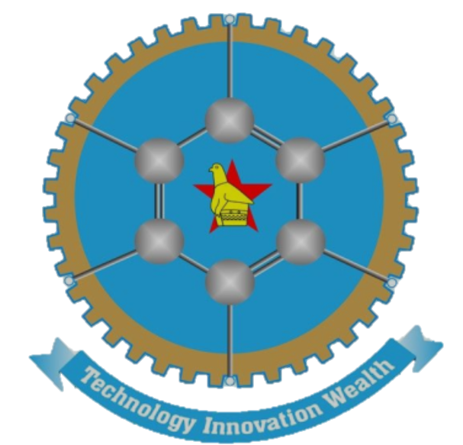
Digital cultural heritage: preserving the past, safeguarding the present and empowering the future
Presented by: FARAI BELIEVE ZVIDZAI
MA DIGITAL HUMANITIES, UZ
BA DUAL HISTORY & SHONA, UZ

Slide 2
WHAT IS DIGITAL CULTURAL HERITAGE
Digital Cultural Heritage (DCH) refers to the preservation, accessibility, dissemination of cultural heritage through digitization and digitalisation (digital technology).
According the Digital Repository of Ireland (2025), ‘…the maintenance of cultural objects through digitisation and digital preservation’.
In Africa’s digital age, cultural heritage is being reimagined through vibrant online platforms, showcasing rich traditions, languages and art forms to a global audience (Reliving 20thcentury in the digital age). – Afrotriumphalist Perspective
This encompasses the convention of physical artifacts, oral histories, documents and other cultural resources into the so-called digital products like 3D models, virtual or augmented reality, mobile applications and online exhibitions.

Slide 3
KEY ASPECTS OF DIGITAL CULTURAL HERITAGE
Digitization
Interdisciplinary collaboration (e.g. Youtuborality and Cyberture)
Digital Preservation
Accessibility
Tangible Heritage
Intangible Heritage
Digital Content Creation

Slide 4
WHY IT (DCH) MATTERS
We are now living in the digital age mainly orchestrated by the so-called digital revolution where our lives are being mediated by the digital.
Most of the human activities is moving into the digital world, into the cyberspace.
Hence, there are five major reasons why digital cultural heritage is essential today:
Cultural identity
National pride
Knowledge transmission
Modernizing Heritage Practices
Access and Inclusion

Slide 5
CONT’D
Rosenzweig notes that, ‘Digitization of cultural heritage is not merely a technological endeavour; it is a moral responsibility to ensure that our history survives the decay of time’.
The aforementioned quotation highlights the role of digitization in preserving cultural heritage for collective memory and identity (Cultural Memory Theory).
DCH is not only about exploration, it is about education.
In short, it connects the past to the future using today’s tools.

Slide 6
CONTEXT: ZIMBABWE’S CULTURAL LANDSCAPE
Zimbabwe in particular and Africa in general has rich tangible and intangible heritage for instance; oral traditions, Shona sculpture, traditional ceremonies.
Indigenous Knowledge Systems – Bodies of knowledge of the indigenous people of a particular geographical areas that they have survived on for a very long time (Mapara, 2009).
Due to the intrusion of external forces, indigenous culture faced serious threats of distortion and misrepresentation. (IKS as combat literature)
King Leopold II’s envoy to Africa Henry Stanley called Africa a ‘Dark Continent’.
‘Because African history, political or otherwise, has been mainly through the eye of the conquerors, missionaries, and adventurer, whose interpretation of Africa and its people in the most cases is a kind of seek fantasy, it is time that Africans tell their own story’ (Clarke, 1991:xi)

Slide 7
EXAMPLES OF DIABOLISED PRACTICES
Worshipping through ancestral spirits
Initiation ceremonies e.g. puberty rituals
Polygamy
Totem Systems
Oral Traditions
This is better explained by the Shona proverbial lore that says in the vernacular, ‘Chirungu chakauya nechirungurira’ (Atriaesthetic Perspective).
The derogatory diction and attitudes expressed by the colonizers used by the whites triggered cultural shock and identity disruption among indigenous communities.
Digital technology now empowers indigenous people to tell their own stories and showcase their culture and Indigenous Knowledge Systems to the world.
Digitafrocentricity is a theory that centres African identity in the digital age, using technology to preserve, reclaim, and amplify African culture and narratives.

Slide 8
PRESERVING THE PAST
Digitization, digitalisation and mechanisation of cultural heritage: Digital preservation allows the natives to capture, store, retrieve and disseminate valuable cultural materials in durable and accessible formats. (Digital Materiality)
For example, archiving historical documents, photographs, and artifacts digitally, ensuring they are not lost with time.
Recording oral histories and traditional stories for posterity.
Institutions like the National Archives of Zimbabwe have been working on digitizing colonial records and liberation war materials.
Some of the Zimbabwean heritage artifacts can be preserved through high-resolution image libraries and artist interviews.

Slide 9
CONT’D
Use of Indigenous Languages: Preserving the past also means maintaining language.
According to Fanon, ‘Language carries a culture’.
This is basically enabled by digitising (IWK) stories, games, songs and oral history in the pre-colonial Zimbabwe and ensure that culture is preserved in its most authentic form.
The importance of Computational Linguistics (NLP).
A notable example of digital products that utilise Shona language as its prime language is an android application for kindergarten named TauraApp (2022).
It includes animal sounds and their respective Shona names, national anthem, and pre-colonial digitized African games that is yet to come.

Slide 10
CONT’D
Digital Storytelling: A process of reimagining traditional folklore (Ngano), myths, and historical narratives creatively through digital tools. For instance:
Podcasts (TheTribblerPodcast)
Animations (I. T Mabasa)
Websites (National Gallery of Zimbabwe)
Social Media Series (African Finder, Hadzabe Tribe)
These platforms engage young audiences while preserving IKS.
The role of User-Generated Content (UGC) in Digital Cultural Heritage.

Slide 11
CONT’D
How is UGC revolutionizing the preservation of cultural heritage?
It enables individuals to document and share their unique traditions, stories and artifacts through photos, videos and personal narratives ensuring they are not lost to time.
UGC offers a diverse and authentic perspective that institutional archive may overlook.
Other powerful tools to focus on besides UGC are FYP and Algorithms.

Slide 12
SAFEGUARDING THE PRESENT
Safeguarding the present means protecting cultural expressions that are still alive or surviving today not archiving the past. HOW?
Promoting Living Heritage Digitally: This literary involves documenting ongoing cultural practices, festivals, music and rituals in real time.
Tools like virtual museums and live streaming make culture accessible, especially to youth and diaspora communities. This includes hosting exhibitions, archives and performances online for public access.
Community Participation Online: Involving local communities in content creation through mobile applications, WhatsApp groups and social media platforms.

Slide 13
CONT’D
Encouraging local ownership: Communities must see themselves as co-creators of digital heritage. Why imitating extra-terrestrial cultural heritage when we carry gold. Quoting Shona native mantra, ‘Nyika inovakwa nevene vayo’. (Combat Literature)
A typical example is the use of foreign filters.
Africa as the cradle of civilization.
The use of digital technology to reclaim African cultural heritage. (Cyber-war)
Empowering local artist to reach global audiences (Digital Marketing) e.g. Jah Prayzah.
According to Chiome (1996:2), ‘Music is the highest form of poetry’.
An artist is the mirror of the society and a voice of the voiceless.

Slide 14
EMPOWERING THE FUTURE
Empowering the future means equipping communities especially the ‘youth’ with digital skills, tools and platforms needed to actively shape, share and sustain their cultural heritage in a rapidly evolving cyber world for instance application of Web 3.0 (The semantic Web and Decentralized Web) – AI and ML.
Digital Literacy for Youth: Equipping the next generation with skills in digitization, content creation and digital storytelling.
Platforms like YouTube, Podcast, mobile apps and social media can become modern tools for cultural transmission. AR and VR experiences of heritage sites for education and tourism.
Digitals skills are key to ensuring young people not only consume cultural content but become active creators and curators.
Youths must move from being passive consumers to active creators of digital cultural content, shaping their heritage through technology.

Slide 15
CONT’D
Cultural Entrepreneurship: Utilizing digital platforms to ‘monetize’ craft, music, dance and traditional knowledge (AIKS).
Promoting local artists and storytellers globally.
CUT motto and its relevance.
Education and Curriculum Integration: Embedding digital heritage in school and university syllabus.
Supporting innovation hubs and digital humanities labs.
This aligns with Education 5.0 which promotes innovation and industrialization through applied skills.
It also supports Vision 2030 and National Development Strategy 1 (NDS1) by building creative industries, promoting social cohesion and encouraging inclusive growth.

Slide 16
Methods and TOOLS
Digital Cultural Heritage today thrives on Web 2.0 Technologies – interactive, user-driven platforms that allows communities to create, share and preserve their cultural identities in real time.
Digital Cultural Heritage is methodological by nature.
Do not learn a programming language, learn a field of software:
Text Analysis: Python and R
Data Visualisation: JavaScript
Web Development: Hyper Textual Mark-up Language (HTML) and Cascading Style Sheets (CSS)
Geographic Information Systems (GIS): Python (Libraries like Geopandas)
Databases Querying: SQL
Artificial Intelligence (AI) and Machine Learning (ML) (Web 3.0): Analyse, restore or interpret heritage. Web 3.0 offers future potential.

Slide 17
CHALLENGES AND ETHICAL ISSUES
Breaking Away From The Convention: Indigenous people forced to abandon their traditions and values. (Western Filters, Exchange of fluffy for staff). Loss of cultural confidence.
Digital Divide: Limited access to internet, electricity and digital tools in rural areas. This creates digital exclusion. (Urban vs Rural)
Cultural Sensitivity: Some practices, objects or knowledge are sacred and not meant for public or digital display. (Ethical Guidelines)
Ownership and Consent: Who controls the content? Were communities consulted?
Intellectual Property Rights: Protecting indigenous knowledge from exploitation or commercial misuse.
Sustainability of Projects: Many digital initiatives lack long-term funding or local capacity to maintain them.
Resistance to Technology (Luddite Mindset): Some cultural custodians fear technology (i.e. AI) will dilute or distort traditions.

Slide 18
CONCLUSION
Digital Cultural Heritage bridges past, present and future.
Empowers communities to preserve, protect and promote their identity. Aligns with Education 5.0, NDS1 and Vision 2030 goals for innovation, heritage and inclusive development.
Calls for ethical community-driven and sustainable approaches.
A digital future rooted in African knowledge systems is not only possible but necessary.

Slide 19
NDATENDA |THANK YOU | NGIYABONGA

